Slide 1


Computer Networks
Week9_Lecture1 (Chapter3)
Transport Layer
Subhan Ullah, PhD
subhan.ullah@nu.edu.pk
BS(Computer Science) Spring-2024

Slide 2

Chapter 3: roadmap
Transport-layer services
Multiplexing and demultiplexing
Connectionless transport: UDP
Principles of reliable data transfer
Connection-oriented transport: TCP
Principles of congestion control
TCP congestion control
Evolution of transport-layer functionality

Slide 3

Principles of reliable data transfer
sending process
receiving process
application
data
data
transport
reliable channel
reliable service abstraction
Notes:
note arrows through reliable data transfer channel is just one way – reliably send from sender to receiver

Slide 4
Principles of reliable data transfer
sending process
receiving process
sending process
receiving process
application
data
data
application
data
data
transport
transport
reliable channel
sender-side of
reliable data transfer protocol
receiver-side
of reliable data transfer protocol
reliable service abstraction
transport
network
unreliable channel
reliable service implementation
Notes:
Spend some time talking about how its to the sender and receiver side protocol that IMPLEMENTS reliable data transfer
Communication over unreliable channel is TWO-way: sender and receiver will exchange messages back and forth to IMPLEMENT one-way reliable data transfer

Slide 5
Principles of reliable data transfer
sending process
receiving process
application
data
data
transport
sender-side of
reliable data transfer protocol
receiver-side
of reliable data transfer protocol
Complexity of reliable data transfer protocol will depend (strongly) on characteristics of unreliable channel (lose, corrupt, reorder data?)
transport
network
unreliable channel
reliable service implementation
Notes:
So we have a sender side and a receiver side. How much work they’ll have to do depends on the IMPAIRMENTS introduced by channel – if the channel is perfect – no problem!

Slide 6

Principles of reliable data transfer
sending process
receiving process
application
data
data
transport
sender-side of
reliable data transfer protocol
receiver-side
of reliable data transfer protocol
Sender, receiver do not know the “state” of each other, e.g., was a message received?
unless communicated via a message
transport
network
unreliable channel
reliable service implementation
Notes:
Here’s a point of view to keep in mind – it’s easy for US to look at sender and receiver together and see what is happening. OH – that message sent was lost.
But think about it say from senders POV How does the sender know if its transmitted message over the unreliable channel got though?? ONLY if receiver somehow signals to the sender that it was received.
The key point here is that one side does NOT know what is going on at the other side – it’s as if there’s a curtain between them. Everything they know about the other can ONLY be learned by sending/receiving messages.
Sender process wants to make sure a segment got through. But it can just somehow magically look through curtain to see if receiver got it. It will be up to the receiver to let the sender KNOW that it (the receiver) has correctly received the segment.
How will the sender and receiver do that – that’s the PROTOCOL.
Before starting to develop a protocol, let’s look more closely at the interface (the API if you will)

Slide 7
Reliable data transfer protocol (rdt): interfaces
rdt_send(): called from above, (e.g., by app.). Passed data to deliver to receiver upper layer
deliver_data(): called by rdt to deliver data to upper layer
sending process
receiving process
rdt_send()
data
data
deliver_data()
data
sender-side
implementation of rdt reliable data transfer protocol
receiver-side
implementation of rdt reliable data transfer protocol
packet
udt_send()
Header
data
Header
data
rdt_rcv()
unreliable channel
udt_send(): called by rdt
to transfer packet over
unreliable channel to receiver
rdt_rcv(): called when packet arrives on receiver side of channel
Bi-directional communication over unreliable channel

Slide 8
Reliable data transfer: getting started
We will:
incrementally develop sender, receiver sides of reliable data transfer protocol (rdt)
consider only unidirectional data transfer
but control info will flow in both directions!
use finite state machines (FSM) to specify sender, receiver
event causing state transition
actions taken on state transition
state: when in this “state” next state uniquely determined by next event
state
1
state
2
event
actions
Notes:
SO let’s get started in developing our reliable data transfer protocol, which we’ll call rdt (need a good acronym for protocol – like HTTP, TCP, UDP, IP)
Bullet points 1 and 2
NOW if we are going to develop a protocol, so we’ll need some way to SPECIFY a protocol. How do we do that?
We could write text, but as all know, that’s prone to misinterpretation, and might be incomplete. You might write a specification, and then think “oh yeah – I forgot about that case”
What we need is more formal way to specify a protocol. In fact, with a formal specification there may be ways to PROVE PROPERTIES about a specification. But that’s an advanced topic we won’t get into here. We’ll start here by adopting a fairly simple protocol specification technique known as finite state machines (FSM)
And as the name might suggest, a central notion of finite state machines is the notion of STATE
<talk about state>

Slide 9

rdt1.0: reliable transfer over a reliable channel
underlying channel perfectly reliable
no bit errors
no loss of packets
separate FSMs for sender, receiver:
sender sends data into underlying channel
receiver reads data from underlying channel
Wait for call from above
rdt_send(data)
Wait for call from below
rdt_rcv(packet)
sender
packet = make_pkt(data)
udt_send(packet)
receiver
extract (packet,data)
deliver_data(data)
Notes:
We’ll start with the simplest case possible - an unreliable channel that is, in fact perfect – no segments are lost, corrupted, dupplicated or reordered. The sender just sends and it pops out the other side(perhaps after some delay) perfectly.

Slide 10
rdt2.0: channel with bit errors
underlying channel may flip bits in packet
checksum (e.g., Internet checksum) to detect bit errors
the question: how to recover from errors?
How do humans recover from “errors” during conversation?

Slide 11
rdt2.0: channel with bit errors
underlying channel may flip bits in packet
checksum to detect bit errors
the question: how to recover from errors?
acknowledgements (ACKs): receiver explicitly tells sender that pkt received OK
negative acknowledgements (NAKs): receiver explicitly tells sender that pkt had errors
sender retransmits pkt on receipt of NAK
stop and wait
sender sends one packet, then waits for receiver response

Slide 12
rdt2.0: FSM specifications
rdt_send(data)
sndpkt = make_pkt(data, checksum)
udt_send(sndpkt)
rdt_rcv(rcvpkt) &&
isNAK(rcvpkt)
sender
Wait for call from above
Wait for ACK or NAK
udt_send(sndpkt)
rdt_rcv(rcvpkt) && corrupt(rcvpkt)
udt_send(NAK)
rdt_rcv(rcvpkt) && isACK(rcvpkt)
Wait for call from below
Λ
receiver
rdt_rcv(rcvpkt) && notcorrupt(rcvpkt)
extract(rcvpkt,data)
deliver_data(data)
udt_send(ACK)

Slide 13
rdt2.0: FSM specification
rdt_send(data)
snkpkt = make_pkt(data, checksum)
udt_send(sndpkt)
rdt_rcv(rcvpkt) &&
isNAK(rcvpkt)
sender
Wait for call from above
Wait for ACK or NAK
isNAK(rcvpkt)
udt_send(sndpkt)
rdt_rcv(rcvpkt) && corrupt(rcvpkt)
udt_send(NAK)
rdt_rcv(rcvpkt) && isACK(rcvpkt)
isACK(rcvpkt)
Wait for call from below
Λ
receiver
Note: “state” of receiver (did the receiver get my message correctly?) isn’t known to sender unless somehow communicated from receiver to sender
that’s why we need a protocol!
rdt_rcv(rcvpkt) && notcorrupt(rcvpkt)
extract(rcvpkt,data)
deliver_data(data)
udt_send(ACK)

Slide 14
rdt2.0: operation with no errors
rdt_send(data)
snkpkt = make_pkt(data, checksum)
udt_send(sndpkt)
rdt_rcv(rcvpkt) &&
isNAK(rcvpkt)
sender
Wait for call from above
Wait for ACK or NAK
udt_send(sndpkt)
rdt_rcv(rcvpkt) && corrupt(rcvpkt)
udt_send(NAK)
rdt_rcv(rcvpkt) && isACK(rcvpkt)
Wait for call from below
Λ
receiver
rdt_rcv(rcvpkt) && notcorrupt(rcvpkt)
extract(rcvpkt,data)
deliver_data(data)
udt_send(ACK)

Slide 15
rdt2.0: corrupted packet scenario
rdt_send(data)
snkpkt = make_pkt(data, checksum)
udt_send(sndpkt)
rdt_rcv(rcvpkt) &&
isNAK(rcvpkt)
sender
Wait for call from above
Wait for ACK or NAK
udt_send(sndpkt)
rdt_rcv(rcvpkt) && corrupt(rcvpkt)
udt_send(NAK)
rdt_rcv(rcvpkt) && isACK(rcvpkt)
Wait for call from below
Λ
receiver
rdt_rcv(rcvpkt) && notcorrupt(rcvpkt)
extract(rcvpkt,data)
deliver_data(data)
udt_send(ACK)
Notes:
Automatic repeat reQuest protocols (ARQ)

Slide 16
rdt2.0 has a fatal flaw!
what happens if ACK/NAK corrupted?
sender doesn’t know what happened at receiver!
can’t just retransmit: possible duplicate
handling duplicates:
sender retransmits current pkt if ACK/NAK corrupted
sender adds sequence number to each pkt
receiver discards (doesn’t deliver up) duplicate pkt
stop and wait
sender sends one packet, then waits for receiver response

Slide 17
rdt2.1: sender, handling garbled ACK/NAKs
Sender sends
Packet 0
rdt_send(data)
sndpkt = make_pkt(0, data, checksum)
udt_send(sndpkt)
rdt_rcv(rcvpkt) && (corrupt(rcvpkt) ||
isNAK(rcvpkt) )
Resend, If
packet is
Corrupt or
NAK recvd
Wait for call 0 from above
Wait for ACK or NAK 0
udt_send(sndpkt)
rdt_rcv(rcvpkt)
&& notcorrupt(rcvpkt) && isACK(rcvpkt)
rdt_rcv(rcvpkt)
&& notcorrupt(rcvpkt)
&& isACK(rcvpkt)
If all is fine
move on and
Send packet 1
Λ
Λ
Wait for ACK or NAK 1
Wait for
call 1 from above
rdt_rcv(rcvpkt)
&& (corrupt(rcvpkt) ||
isNAK(rcvpkt) )
rdt_send(data)
Sender sends
Packet 1 …
udt_send(sndpkt)
sndpkt = make_pkt(1, data, checksum)
udt_send(sndpkt)

Slide 18
rdt2.1: receiver, handling garbled ACK/NAKs
rdt_rcv(rcvpkt) && notcorrupt(rcvpkt)
&& has_seq0(rcvpkt)
Packet received correctly with
seq0, extract and deliver data to
upper layers and send back ACK
Packet received but corrupt, send NAK
extract(rcvpkt,data)
deliver_data(data)
sndpkt = make_pkt(ACK, chksum)
udt_send(sndpkt)
rdt_rcv(rcvpkt) && (corrupt(rcvpkt)
rdt_rcv(rcvpkt) && (corrupt(rcvpkt)
sndpkt = make_pkt(NAK, chksum)
udt_send(sndpkt)
sndpkt = make_pkt(NAK, chksum)
udt_send(sndpkt)
Wait for
0 from below
Wait for
1 from below
rdt_rcv(rcvpkt) &&
not corrupt(rcvpkt) &&
has_seq1(rcvpkt)
rdt_rcv(rcvpkt) &&
not corrupt(rcvpkt) &&
has_seq0(rcvpkt)
sndpkt = make_pkt(ACK, chksum)
udt_send(sndpkt)
sndpkt = make_pkt(ACK, chksum)
udt_send(sndpkt)
rdt_rcv(rcvpkt) && notcorrupt(rcvpkt)
&& has_seq1(rcvpkt)
Packet received, not corrupt but has seq 1,
Send ACK again
Packet received, not corrupt but has seq 0,
Send ACK again
extract(rcvpkt,data)
deliver_data(data)
sndpkt = make_pkt(ACK, chksum)
udt_send(sndpkt)

Slide 19
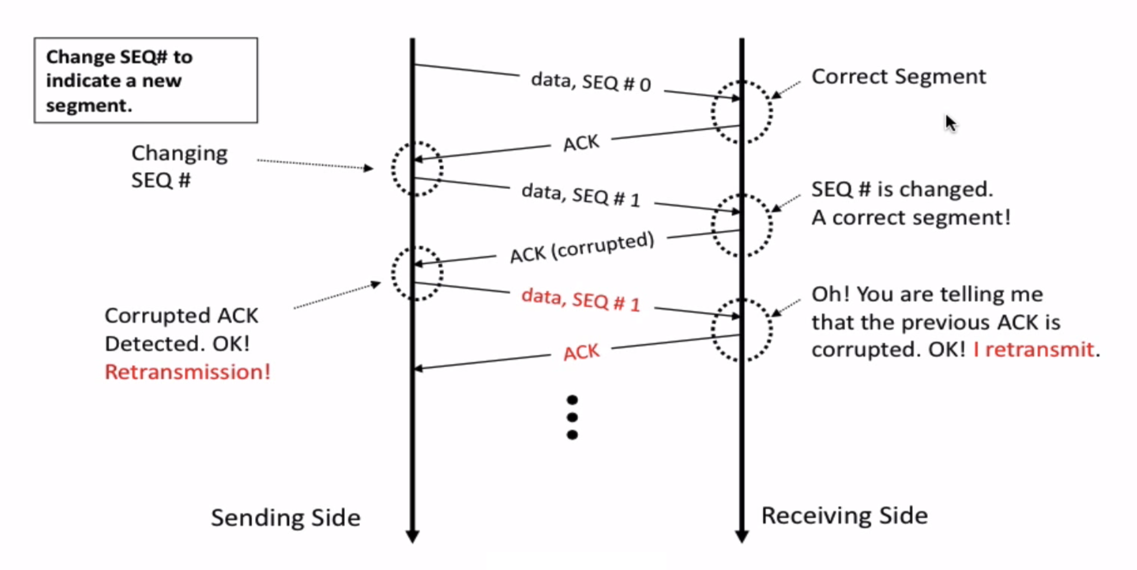
rdt2.1 in Action

Slide 20
rdt2.1: discussion
sender:
seq # added to pkt
two seq. #s (0,1) will suffice. Why?
must check if received ACK/NAK corrupted
twice as many states
state must “remember” whether “expected” pkt should have seq # of 0 or 1
receiver:
must check if received packet is duplicate
state indicates whether 0 or 1 is expected pkt seq #
note: receiver can not know if its last ACK/NAK received OK at sender
Notes:
two seq. #’s (0,1) will suffice. Why?
Because the stop-and-wait property of this protocol.
If the sending side does not wait for the acknowledgements, then this method would fail.

Slide 21
rdt2.2: a NAK-free protocol
same functionality as rdt2.1, using ACKs only
instead of NAK, receiver sends ACK for last pkt received OK
receiver must explicitly include seq # of pkt being ACKed
duplicate ACK at sender results in same action as NAK: retransmit current pkt
As we will see, TCP uses this approach to be NAK-free
Notes:
If a corrupted packet is found, the ACK segment with the SEQ# of the previously acknowledge segment is sent to the sending side.
Duplicated acknowledgment methodology is really used in the real protocol - TCP

Slide 22
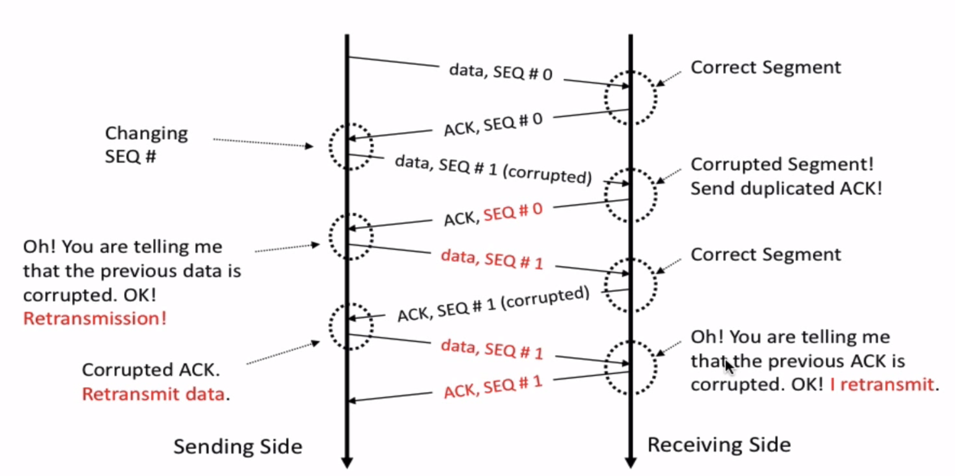
Rdt 2.2 in action
Notes:
Section G (covered 10/27/2021).

Slide 23
rdt2.2: sender, receiver fragments
rdt_send(data)
sndpkt = make_pkt(0, data, checksum)
udt_send(sndpkt)
rdt_rcv(rcvpkt) &&
( corrupt(rcvpkt) ||
isACK(rcvpkt,1) )
Wait for call 0 from above
Wait for ACK
0
udt_send(sndpkt)
sender FSM
fragment
rdt_rcv(rcvpkt)
&& notcorrupt(rcvpkt)
&& isACK(rcvpkt,0)
rdt_rcv(rcvpkt) &&
(corrupt(rcvpkt) ||
has_seq1(rcvpkt))
Λ
Wait for
0 from below
receiver FSM
fragment
udt_send(sndpkt)
rdt_rcv(rcvpkt) && notcorrupt(rcvpkt)
&& has_seq1(rcvpkt)
extract(rcvpkt,data)
deliver_data(data)
sndpkt = make_pkt(ACK1, chksum)
udt_send(sndpkt)

Slide 24
rdt2.2: a NAK free protocol - Sender
rdt_send(data)
Sender sends
Packet 0
sndpkt = make_pkt(0, data, checksum)
udt_send(sndpkt)
rdt_rcv(rcvpkt) &&
( corrupt(rcvpkt) ||
isACK(rcvpkt,1))
Resend, If
packet is
Corrupt or
duplicate ACK
Wait for call 0 from above
Wait for ACK or NAK 0
udt_send(sndpkt)
rdt_rcv(rcvpkt)
&& notcorrupt(rcvpkt)
&& isACK(rcvpkt,1)
rdt_rcv(rcvpkt)
&& notcorrupt(rcvpkt)
&& isACK(rcvpkt,0)
If all is fine
move on and
Send packet 1
Λ
Λ
Wait for ACK or NAK 1
Wait for
call 1 from above
rdt_rcv(rcvpkt) &&
( corrupt(rcvpkt) ||
isACK(rcvpkt,0))
rdt_send(data)
Sender sends
Packet 1 …
udt_send(sndpkt)
sndpkt = make_pkt(1, data, checksum)
udt_send(sndpkt)

Slide 25
rdt2.2: a NAK free protocol - Receiver
rdt_rcv(rcvpkt) && notcorrupt(rcvpkt)
&& has_seq0(rcvpkt)
Packet received correctly with
seq0, extract and deliver data to
upper layers and send back ACK
Packet received but corrupt, send NAK
extract(rcvpkt,data)
deliver_data(data)
sndpkt = make_pkt(ACK, chksum)
udt_send(sndpkt)
rdt_rcv(rcvpkt) && (corrupt(rcvpkt)
rdt_rcv(rcvpkt) && (corrupt(rcvpkt)
sndpkt = make_pkt(NAK, chksum)
udt_send(sndpkt)
sndpkt = make_pkt(NAK, chksum)
udt_send(sndpkt)
Wait for
0 from below
Wait for
1 from below
rdt_rcv(rcvpkt) &&
not corrupt(rcvpkt) &&
has_seq1(rcvpkt)
rdt_rcv(rcvpkt) &&
not corrupt(rcvpkt) &&
has_seq0(rcvpkt)
sndpkt = make_pkt(ACK, chksum)
udt_send(sndpkt)
sndpkt = make_pkt(ACK, chksum)
udt_send(sndpkt)
rdt_rcv(rcvpkt) && notcorrupt(rcvpkt)
&& has_seq1(rcvpkt)
Packet received, not corrupt but has seq 1,
Send ACK again
Packet received, not corrupt but has seq 0,
Send ACK again
extract(rcvpkt,data)
deliver_data(data)
sndpkt = make_pkt(ACK, chksum)
udt_send(sndpkt)

Slide 26
rdt2.2: a NAK free protocol - Receiver
rdt_rcv(rcvpkt) && notcorrupt(rcvpkt)
&& has_seq0(rcvpkt)
Packet received correctly with
seq0, extract and deliver data to
upper layers and send back ACK
extract(rcvpkt,data)
deliver_data(data)
sndpkt = make_pkt(ACK, chksum)
udt_send(sndpkt)
rdt_rcv(rcvpkt) && (corrupt(rcvpkt)
rdt_rcv(rcvpkt) &&
(corrupt(rcvpkt) ||
has_seq1(rcvpkt))
sndpkt = make_pkt(NAK, chksum)
udt_send(sndpkt)
Wait for
0 from below
Wait for
1 from below
sndpkt=make_pkt(ACK,1,checksum)
udt_send(sndpkt)
rdt_rcv(rcvpkt) &&
not corrupt(rcvpkt) &&
has_seq0(rcvpkt)
sndpkt = make_pkt(ACK, chksum)
udt_send(sndpkt)
rdt_rcv(rcvpkt) && notcorrupt(rcvpkt)
&& has_seq1(rcvpkt)
Packet received, not corrupt but has seq 0,
Send ACK again
extract(rcvpkt,data)
deliver_data(data)
sndpkt = make_pkt(ACK, chksum)
udt_send(sndpkt)

Slide 27
rdt2.2: a NAK free protocol - Receiver
rdt_rcv(rcvpkt) && notcorrupt(rcvpkt)
&& has_seq0(rcvpkt)
extract(rcvpkt,data)
deliver_data(data)
sndpkt = make_pkt(ACK, chksum)
udt_send(sndpkt)
rdt_rcv(rcvpkt) &&
(corrupt(rcvpkt) ||
has_seq1(rcvpkt))
rdt_rcv(rcvpkt) &&
(corrupt(rcvpkt) ||
has_seq0(rcvpkt))
Wait for
0 from below
Wait for
1 from below
sndpkt=make_pkt(ACK,1,checksum)
udt_send(sndpkt)
sndpkt=make_pkt(ACK,0,checksum)
udt_send(sndpkt)
rdt_rcv(rcvpkt) && notcorrupt(rcvpkt)
&& has_seq1(rcvpkt)
extract(rcvpkt,data)
deliver_data(data)
sndpkt = make_pkt(ACK, chksum)
udt_send(sndpkt)

Slide 28


Thank You All
☺
?
A note on the origin of these ppt slides:
All material copyright 1996-2020 J.F Kurose and K.W. Ross, All Rights Reserved
These slides are freely provided by the book authors and it represents a lot of work on their part. We would like to thank J.F Kurose and K.W. Ross.
Transport Layer: 3-150
Notes:
Section F and G ended

